Slide 1
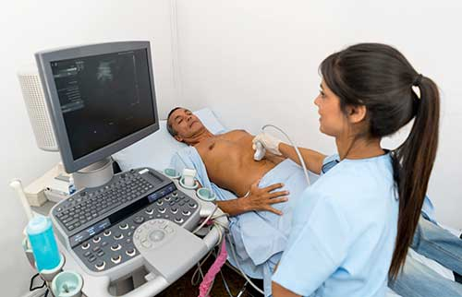
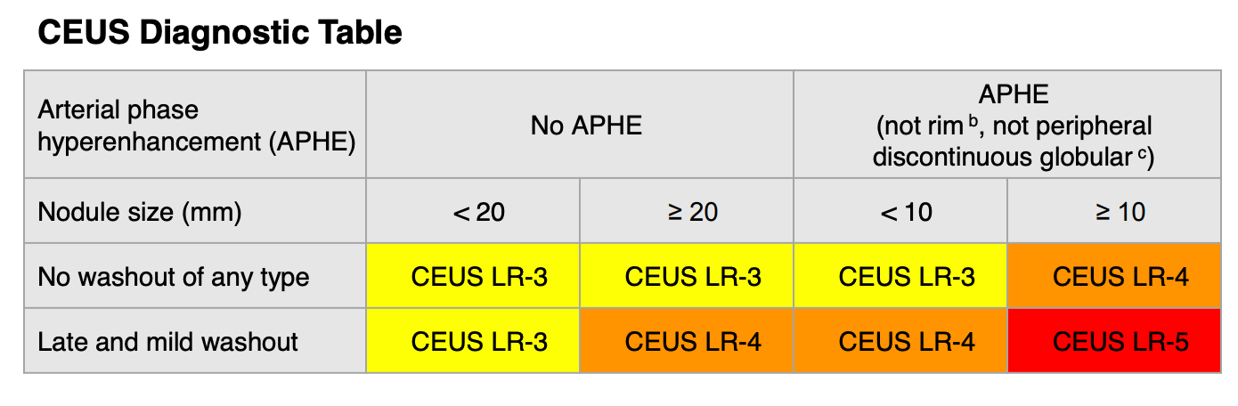
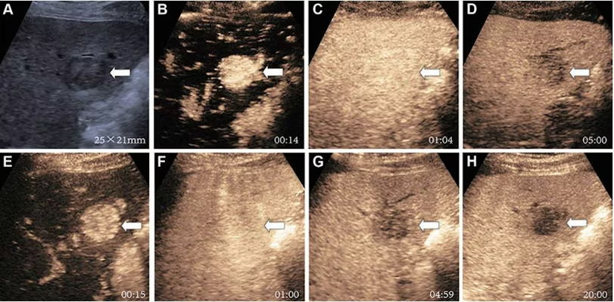
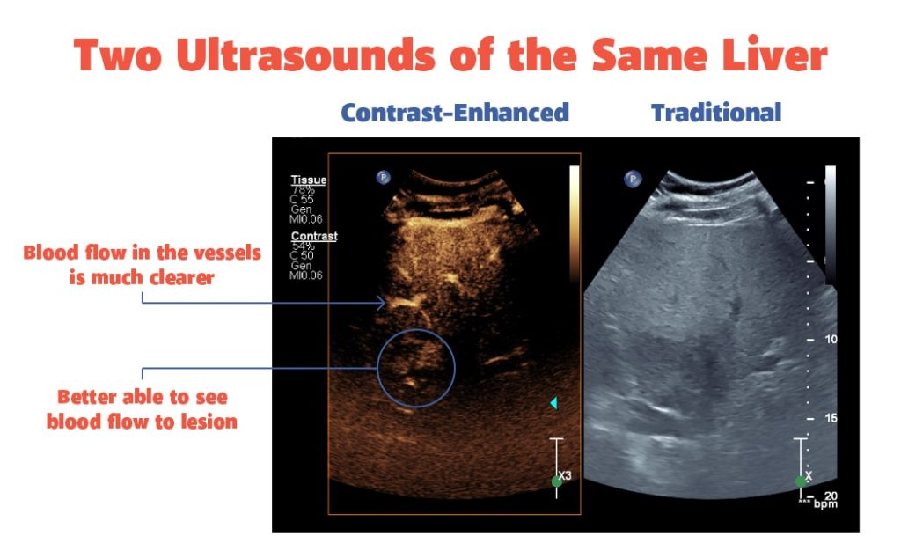
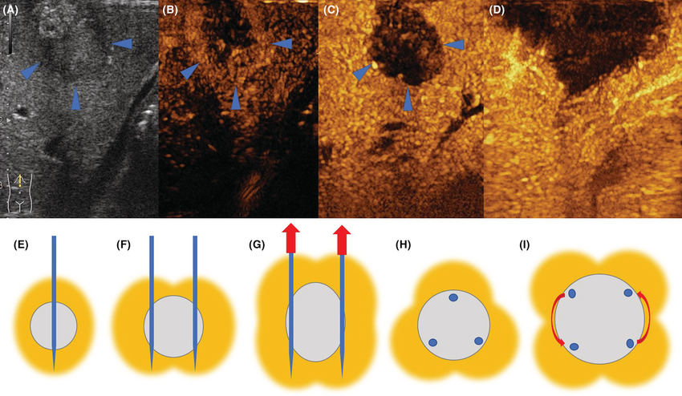
Contrast-Enhanced Ultrasound (CEUS)
Other Applications of CEUS
In 2026, contrast-enhanced non-cardiac ultrasound is only approved in the United States for characterization of adult and pediatric liver lesions and for pediatric voiding urosonography.¹⁴ International and off-label research has shown promising applications of CEUS in many other areas, including:
Characterization of renal masses & lesions¹²
Diagnosis of pancreatic malignancy¹⁵
Monitoring of medical tumor treatment¹⁵
Post-transplant surveillance¹⁵
Guidance of biopsy and interventional procedures¹⁵
Materials, Technique, and Procedure
Note. Adapted from "Abdominal Contrast Enhanced Ultrasound (CEUS)," by RadiologyInfo.org, 2024.
The agents currently available in the United States for liver imaging are the second-generation contrast agents from SonoVue/Lumason and Definity/Luminity. ⁹
Because the microbubbles are strictly intravascular, the agents are typically smaller than 7 micrometers so that they can flow smoothly through capillary beds. ⁹
When focusing on liver lesions, the entire liver should be swept through before contrast administration to screen for lesions or other types of pathology that could be present. ¹¹
The ultrasound contrast is administered by an IV, then a saline flush is administered. ⁹
Times should be recorded with each image taken, starting at the time the microbubbles appear on the display to around 30-45 seconds after that to capture the peak arterial phase. ⁹
To assess for lesion washout, intermittent scanning should be done every 30 seconds for up to 5 minutes after the initial injection. ¹¹
What is Contrast-Enhanced Ultrasound?
Contrast-Enhanced Ultrasound (CEUS) uses an injected contrast agent to increase the reflectivity of flowing blood in ultrasound images.
The contrast agents consist of tiny gas-filled microspheres (microbubbles) that respond to ultrasound waves non-linearly, generating harmonic frequencies that can be captured by the receiver. ¹
As early as 1968, this approach was reported by cardiac sonographers and was refined to be used in general circulation by Japanese sonographers in the late 1980s.
CEUS was first granted regulatory approval in Europe in the early 1990s and has been widespread for non-cardiac applications – particularly in the diagnosis of focal liver lesions (FLL), for decades outside of the United States. ²
Note. Adapted from CEUS LI-RADS v2017 core (p. 23), by American College of Radiology, 2017.
Findings
References
The observed contrast phases and findings are similar to CT:
Arterial phase: ~10sec to ~45sec
- Demonstrates the lesion’s uptake of blood from the hepatic arteries
2. Portal venous phase: ~45sec to ~120sec
- Demonstrates the lesion’s uptake of blood from the portal venous system
3. Late phase: ~120sec till the clearance of blood
- Demonstrates blood drainage from lesion⁵
Benign lesions are usually isovascular, demonstrating similar uptake and washout to surrounding hepatic tissue. Malignant tissues often demonstrate hypervascular uptake and rapid venous washout.¹¹
1.Edelman SK. Understanding Ultrasound Physics. 4th ed. ESP Ultrasound; 2012.
2.Dietrich CF, Albrecht T, Becher H, et al. History of contrast enhanced ultrasound (CEUS). Med Ultrason. 2024;26(4):405-416. doi:https://doi.org/10.11152/mu-4366
3.Chammas MC, Bordini A. Contrast-enhanced ultrasound (CEUS) for evaluation of main malignant focal lesions. Ultrasonography. 2022;41(1):4-24. doi:https://doi.org/10.14366/usg.21001
4.Morel DR, Schwieger IM, Höhn L, et al. Human Pharmacokinetics and Safety Evaluation of SonoVueTM, a New Contrast Agent for Ultrasound Imaging. Invest Radiol. 2000;35(1):80-80. doi:https://doi.org/10.1097/00004424-200001000-00009
5.Dietrich CF, Nolsøe CP, Barr RG, et al. Guidelines and Good Clinical Practice Recommendations for Contrast-Enhanced Ultrasound (CEUS) in the Liver–Update 2020 WFUMB in Cooperation with EFSUMB, AFSUMB, AIUM, and FLAUS. Ultrasound Med Biol. 2020;46(10):2579-2604. doi:https://doi.org/10.1016/j.ultrasmedbio.2020.04.030
6.Jo PC, Jang HJ, Burns PN, Burak KW, Kim TK, Wilson SR. Integration of Contrast-enhanced US into a Multimodality Approach to Imaging of Nodules in a Cirrhotic Liver: How I Do It. Radiology. 2017;282(2):317-331. doi:https://doi.org/10.1148/radiol.2016151732
7.Streb JW, Tchelepi H, Malhi H, Deurdulian C, Grant EG. Retrospective Analysis of Contrast-enhanced Ultrasonography Effectiveness in Reducing Time to Diagnosis and Imaging-related Expenditures at a Single Large United States County Hospital. Ultrasound Q. 2019;35(2):99-102. doi:https://doi.org/10.1097/ruq.0000000000000375
8.Merkle EM, Bamberg F, Vosshenrich J. The Impact of Modern Imaging Techniques on Carbon Footprints: Relevance and Outlook. Eur Urol Focus. 2023;9(6). doi:https://doi.org/10.1016/j.euf.2023.09.009
9.Radiological Society of North America (RSNA), American College of Radiology (ACR), American Society of Radiologic Technologists (ASRT). Abdominal Contrast Enhanced Ultrasound (CEUS). Radiologyinfo.org. Published September 23, 2024. Accessed March 13, 2026. https://www.radiologyinfo.org/en/info/contrast-enhanced-ultrasound
10.Pang EHT, Chan A, Ho SG, Harris AC. Contrast-Enhanced Ultrasound of the Liver: Optimizing Technique and Clinical Applications. AJR Am J Roentgenol. 2018;210(2):320-332. doi:https://doi.org/10.2214/ajr.17.17843
11.D’Onofrio M, Crosara S, De Robertis R, Canestrini S, Mucelli RP. Contrast-Enhanced Ultrasound of Focal Liver Lesions. AJR Am J Roentgenol. 2015;205(1):W56-W66. doi:https://doi.org/10.2214/ajr.14.14203
12.AIUM Practice Parameter for the Performance of Contrast‐Enhanced Ultrasound. J Ultrasound Med. 2024;43(3):E8-E19. doi:https://doi.org/10.1002/jum.16360
13.Barr RG. How to Develop a Contrast-Enhanced Ultrasound Program. J Ultrasound Med. 2017;36(6):1225-1240. doi:https://doi.org/10.7863/ultra.16.09045
14.Barr RG. The Urgent Need for FDA to Approve a Whole‐Body Application of Ultrasound Contrast Agents. J Ultrasound Med. 2023;42(4):761-764. doi:https://doi.org/10.1002/jum.16092
15.Sidhu P, Cantisani V, Dietrich C, et al. The EFSUMB Guidelines and Recommendations for the Clinical Practice of Contrast-Enhanced Ultrasound (CEUS) in Non-Hepatic Applications: Update 2017 (Long Version). Ultraschall in Med. 2018;39(02):e2-e44. doi:https://doi.org/10.1055/a-0586-1107
16.Burgess P. IAC & ICUS Present: IV Insertion by a Sonographer. Intersocietal Accreditation Commission. Published November 18, 2019. Accessed March 14, 2026. https://www.youtube.com/watch?v=dQr8vQ8PT9g
17.Scope of Practice and Clinical Standards for the Diagnostic Medical Sonographer. J Diagn Med Sonogr. 2024;40(3). doi:https://doi.org/10.1177/87564793241242633
18.Mulvagh SL, Mitchell C, Bagley J, et al. A Survey of CEUS Education in Sonographer Training Programs: The Well-Opacified and Delineated Road Less Travelled, and Ready to be Taken. J Am Soc Echocardiogr. 2020;33(9):A19-A21. doi:https://doi.org/10.1016/j.echo.2020.07.010
19.Stempniak M. Medicare doubles payment for certain contrast-enhanced ultrasound scans. Radiology Business. Published November 26, 2025. Accessed March 14, 2026. https://radiologybusiness.com/topics/healthcare-management/healthcare-policy/medicare-doubles-payment-certain-contrast-enhanced-ultrasound-scans
20.Strom JB, Appis A, Barr RG, et al. Multi-societal expert consensus statement on the safe administration of ultrasound contrast agents. Echo Res Pract. 2025;12(1). doi:https://doi.org/10.1186/s44156-024-00068-7
21.Singal AG, Llovet JM, Yarchoan M, et al. AASLD practice guidance on prevention, diagnosis, and treatment of hepatocellular carcinoma. Hepatology. 2023;78(6):1922-1965. doi:https://doi.org/10.1097/hep.0000000000000466
22.Sonography schools to expand Contrast-Enhanced Ultrasound (CEUS) training. News release. International Contrast Ultrasound Society. Published January 6, 2026. Accessed March 14, 2026. https://icus-society.org/sonography-schools-to-expand-contrast-enhanced-ultrasound-ceus-training/
Why use CEUS for FLL?
Sensitive and specific mode of evaluation of benign and malignant liver tumors, with accuracy compared to CT. ³
Contrast is eliminated from the blood via the pulmonary route, bypassing the kidneys, allowing safe administration to patients with renal insufficiency or allergies to CT/MRI contrast. ^{4,5}
Pregnant and pediatric patients can be assessed safely via CEUS without exposure to ionizing radiation. ⁵
Allows for non-invasive resolution of indeterminate CT and MRI findings. ⁶
May be particularly useful for detecting small (<10mm) metastases. ³
CEUS costs less than CT and MRI and can easily be performed at the time of initial examination, allowing for significantly shorter time to diagnose. ⁷
Ultrasound machines use less energy and emit far less carbon over the course of a year compared to CT and MRI machines. ⁸
Note. Adapted from "CEUS with perfluorobutane improves HCC diagnosis," by K. Yee, 2023, AuntMinnie.com.
Limitations to CEUS
Adoption in the US
CEUS can be limited by body habitus just like other forms of transabdominal ultrasound. ⁹
Other limitations found in utilizing the CEUS method to assess and diagnose liver lesions are typically the same when it comes to ultrasound and all imaging modalities: technique, experience, and in the case of CEUS – understanding the physics of microbubbles and how different settings in ultrasound can be affected by the microbubbles’ signal. ¹⁰
Because of the real-time nature of CEUS, multiple lesions in different planes of view cannot be imaged simultaneously. However, the half-life of the contrast agents is short, and multiple doses can be administered in a single exam. ^{9,11}
Allergic reactions are rare, but resuscitation equipment and trained personnel must be available during CEUS exams. ¹²
CEUS imaging required the installation of contrast-specific software, which is offered by many ultrasound vendors including GE, Phillips, and Siemens. ¹³
In 2016, SonoVue/Lumason was the first contrast agent to be approved in the United States for contrast-enhanced liver ultrasound.¹³
Adoption in the years since has been slow, with one of the biggest obstacles being that CEUS studies require the participation of an additional, intravenous-certified medical professional beyond the sonographer.¹⁶
In 2020, less than 20% of surveyed American ultrasonography schools taught IV insertion and only 5% certified their students to place IVs.¹⁸
Recent changes suggest momentum may be building towards broader adoption of CEUS, though. In 2024, the Society for Diagnostic Medical Sonography (SDMS) updated The Scope of Practice and Clinical Standards for the Diagnostic Medical Sonographer to include intravenous line insertion and contrast agent administration.¹⁷
An expert consensus statement laying out explicit guidelines for the administration of ultrasound contrast agents by sonographers was published last year and endorsed by professional organizations around the world, including the SDMS and the Joint Review Committee for Diagnostic Medical Sonography (JRC-DMS).²⁰
Accordingly, upcoming revisions to the National Education Curriculum published by JRC-DMS and used by sonography programs across the nation will include expanded training in CEUS.²²
On the demand side, Medicare recently doubled the reimbursement rate for non-cardiac CEUS exams, reassigning non-cardiac contrast ultrasound to the same billing code used for contrast-enhanced CT and MRI.¹⁹
Note. Adapted from "Contrast Ultrasound: What It’s Used For and 4 Key Advantages," by UVA Radiology, 2017, UVA Radiology Blog.
Note. CEUS images and diagram of the arrangement of the needles. From "Role of Sonazoid enhanced ultrasound assistant laparoscopic radiofrequency ablation in treating liver malignancy-A single-center retrospective cohort study," by J. Y. Xu, Y. Liu, M. Wu, and C. Li, 2023, Cancer Medicine. Copyright 2023 by the authors.

